Slide 1

Always think out of the box
What is the definition of life?

Slide 2
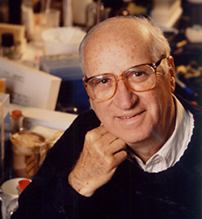
The Seven Pillars of Life
DANIEL E. KOSHLAND, JR.
SCIENCE 22 Mar 2002 Vol 295, Issue 5563 pp. 2215-2216
DOI: 10.1126/science.1068489
What is the definition of life? I remember a conference of the scientific elite that sought to answer that question. Is an enzyme alive? Is a virus alive? Is a cell alive? After many hours of launching promising balloons that defined life in a sentence, followed by equally conclusive punctures of these balloons, a solution seemed at hand: “The ability to reproduce—that is the essential characteristic of life,” said one statesman of science. Everyone nodded in agreement that the essential of a life was the ability to reproduce, until one small voice was heard. “Then one rabbit is dead. Two rabbits—a male and female—are alive but either one alone is dead.” At that point, we all became convinced that although everyone knows what life is there is no simple definition of life.

Slide 3
Seven Pillars of Life
P: Program
I: Improvisation
C: Compartmentalization
E: Energy
R: Regeneration
A: Adaptability
S: Seclusion

